Slide 1


System Analysis of an AI-Based Flight Booking Chatbot
Reverse Engineering of Architecture, Components and Working Process
CO5 Assessment Tool 3-Technical Presentation
Name: K.S.DHARSHANA
Register No:192412015
Artificial Intelligence – CSA1709

Slide 2
System Overview
• AI-based chatbot that helps users find and book flights
• Understands travel requirements through natural language
• Identifies missing information and asks relevant questions
• Searches available flights and suggests suitable options
• Main goal: help the user find a suitable flight
Example: User → “I want to book a flight to Chennai next Friday.”
Chatbot → asks for departure time and preferred airline

Slide 3
PEAS Description
P – Performance: Correct flight selection, quick response and successful booking
E – Environment: Users, airlines, flight schedules, seats and ticket prices
A – Actuators: Replies, questions, flight options and booking actions
S – Sensors: User messages and travel requirements
Agent Type: Goal-Based Agent
The chatbot uses user information to achieve the goal of finding a suitable flight.

Slide 4
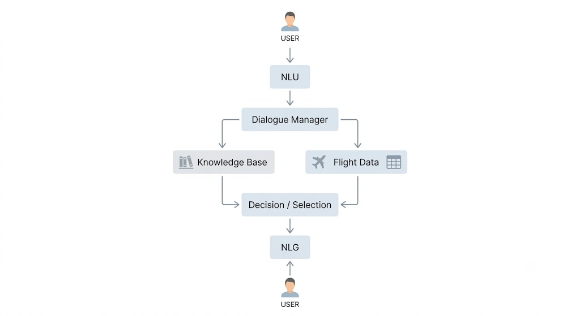
System Architecture

Slide 5
Working & Data Flow
1. User gives destination and date
2. NLU extracts important details
3. Dialogue Manager checks for missing information
4. User provides preferred time
5. Flight information is retrieved
6. Suitable flights are identified
7. NLG generates the final response
Example: “Morning flight, no preference” → 3 morning flights found → cheapest option suggested

Slide 6
Findings & Enhancement
Reverse-Engineering Findings
• NLU understands user requirements
• Dialogue Manager manages the conversation
• Knowledge Base provides flight information
• NLG produces the response
• System works toward the booking goal
Proposed Enhancement: Add a Learning Component
It can learn user preferences such as preferred timings and cheaper options, improving future recommendations.
Conclusion: Reverse engineering helps identify how the AI system receives input, processes it and produces decisions.

